Slide 1
Machine Learning INT404

Slide 2
Supervised Machine Learning
<The majority of practical machine learning uses supervised learning.
<Supervised learning is where you have input variables (x) and an output variable (Y) and you use an algorithm to learn the mapping function from the input to the output.
Y = f(X)
<The goal is to approximate the mapping function so well that when you have new input data (x) that you can predict the output variables (Y) for that data.

Slide 3
Continue
It is called supervised learning because the process of an algorithm learning from the training dataset can be thought of as a teacher supervising the learning process.
We know the correct answers, the algorithm iteratively makes predictions on the training data and is corrected by the teacher. Learning stops when the algorithm achieves an acceptable level of performance.

Slide 4
<Supervised learning as the name indicates a presence of supervisor as teacher. Basically supervised learning is a learning in which we teach or train the machine using data which is well labeled that means some data is already tagged with correct answer.
<After that, machine is provided with new set of examples(data) so that supervised learning algorithm analyses the training data(set of training examples) and produces an correct outcome from labeled data.

Slide 5
Example
Fruit Basket:- suppose you are given an basket filled with different kinds of fruits. Now the first step is to train the machine with all different fruits one by one like this:
If shape of object is rounded and depression at top having color Red then it will be labelled as –Apple.
If shape of object is long curving cylinder having color Green-Yellow then it will be labelled as –Banana.
<Now suppose after training the data, you have given a new separate fruit say Banana from basket and asked to identify it. <Since machine has already learnt the things from previous data and this time have to use it wisely. It will first classify the fruit with its shape and color, and would confirm the fruit name as BANANA and put it in Banana category. Thus machine learns the things from training data(basket containing fruits) and then apply the knowledge to test data(new fruit).

Slide 6
Supervised learning problems can be further grouped into regression and classification problems.
Classification: A classification problem is when the output variable is a category, such as “red” or “blue” or “disease” and “no disease”.
Regression: A regression problem is when the output variable is a real value, such as “dollars” or “weight”.
Example:-
Which of the following is a regression task?
Predicting age of a person
Predicting nationality of a person
Predicting whether stock price of a company will increase tomorrow
Predicting whether a document is related to sighting of UFOs?

Slide 7
Continue
Solution : Predicting age of a person (because it is a real value, predicting nationality is categorical, whether stock price will increase is discreet-yes/no answer, predicting whether a document is related to UFO is again discreet- a yes/no answer).

Slide 8
Some popular examples of supervised machine learning algorithms are:
Linear regression for regression problems.
Random forest for classification and regression problems.
Support vector machines for classification problems.

Slide 9
Unsupervised Learning
Unsupervised learning is where you only have input data (X) and no corresponding output variables.
The goal for unsupervised learning is to model the underlying structure or distribution in the data in order to learn more about the data.
These are called unsupervised learning because unlike supervised learning above there is no correct answers and there is no teacher. Algorithms are left to their own devises to discover and present the interesting structure in the data.

Slide 10
Continue
Unsupervised learning is the training of machine using information that is neither classified nor labeled and allowing the algorithm to act on that information without guidance.
Here the task of machine is to group unsorted information according to similarities, patterns and differences without any prior training of data.
Unlike supervised learning, no teacher is provided that means no training will be given to the machine. Therefore machine is restricted to find the hidden structure in unlabeled data by our-self.

Slide 11
Example
suppose it is given an image having both dogs and cats which have not seen ever.
Thus machine has no any idea about the features of dogs and cat so we can’t categorize it in dogs and cats. But it can categorize them according to their similarities, patterns and differences i.e., we can easily categorize the into two parts.
First first may contain all pics having dogs in it and second part may contain all pics having cats in it. Here you didn’t learn anything before, means no training data or examples.

Slide 12
Continue
Unsupervised learning classified into two categories of algorithms:
Clustering: A clustering problem is where you want to discover the inherent groupings in the data, such as grouping customers by purchasing behavior.
Association: An association rule learning problem is where you want to discover rules that describe large portions of your data, such as people that buy X also tend to buy Y.
Some popular examples of unsupervised learning algorithms are:
k-means for clustering problems.
Apriori algorithm for association rule learning problems.

Slide 13
Reinforcement Learning
Reinforcement learning is an area of Machine Learning. Reinforcement.
It is about taking suitable action to maximize reward in a particular situation. It is employed by various software and machines to find the best possible behavior or path it should take in a specific situation.
Reinforcement learning differs from the supervised learning in a way that in supervised learning the training data has the answer key with it so the model is trained with the correct answer itself whereas in reinforcement learning, there is no answer but the reinforcement agent decides what to do to perform the given task. In the absence of training dataset, it is bound to learn from its experience.

Slide 14
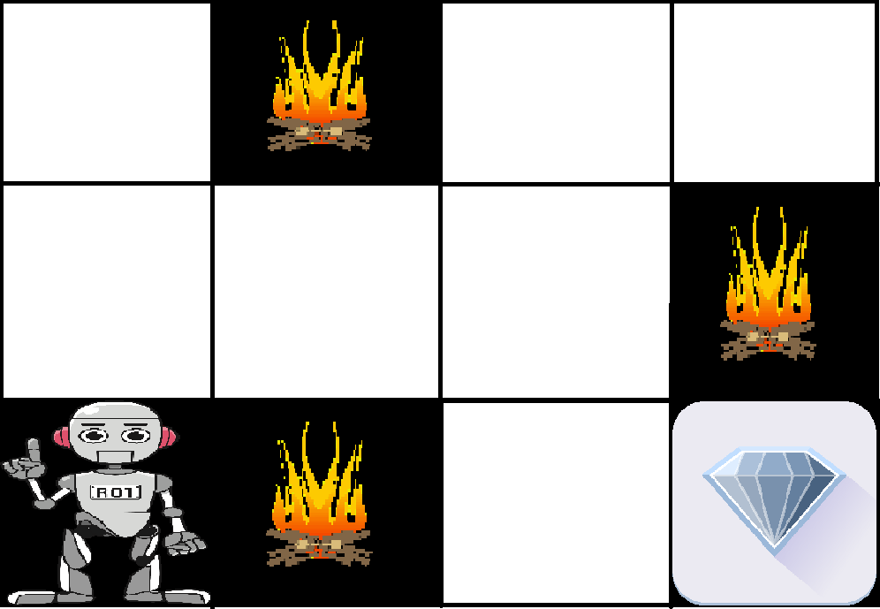
Example
The problem is as follows: We have an agent and a reward, with many hurdles in between. The agent is supposed to find the best possible path to reach the reward. The following problem explains the problem more easily.

Slide 15
Continue
The above image shows robot, diamond and fire. The goal of the robot is to get the reward that is the diamond and avoid the hurdles that is fire.
The robot learns by trying all the possible paths and then choosing the path which gives him the reward with the least hurdles.
Each right step will give the robot a reward and each wrong step will subtract the reward of the robot. The total reward will be calculated when it reaches the final reward that is the diamond.

Slide 16
RL
Main points in Reinforcement learning –
Input: The input should be an initial state from which the model will start
Output: There are many possible output as there are variety of solution to a particular problem
Training: The training is based upon the input, The model will return a state and the user will decide to reward or punish the model based on its output.
The model keeps continues to learn.
The best solution is decided based on the maximum reward.

Slide 17
Types of RL
Positive – Positive Reinforcement is defined as when an event, occurs due to a particular behavior, increases the strength and the frequency of the behavior. In other words it has a positive effect on the behavior.
Advantages of reinforcement learning are:
Maximizes Performance
Sustain Change for a long period of time
Disadvantages of reinforcement learning:
Too much Reinforcement can lead to overload of states which can diminish the results
Negative – Negative Reinforcement is defined as strengthening of a behavior because a negative condition is stopped or avoided.
Advantages of reinforcement learning:
Increases Behavior
Provide defiance to minimum standard of performance
Disadvantages of reinforcement learning:
It Only provides enough to meet up the minimum behavior

Slide 18
